Slide 1
IO-Link Safety
Digitalization down to smallest functional safe Sensors/Actuators/Mechatronics
"Event"
"Presenter's name"
Hint: Use presentation view "Notes Page" for accompanying Information
Notes:
Please enter at your convenience:
Presenter's name
Date of Event
Event (meeting, workshop, etc.)
Location of Event
For any changes, be it corrections, extensions, or translations please contact:
info@io-link.com
Hint: Use presentation view "Notes Page" for accompanying Information

Slide 2
Overview
Status of IO-Link and Basics
What is OSSDe all about?
Fieldbuses and Functional Safety Communication Profiles (FSCPs)
Requirements of Customers and Manufacturers
Why a new safe communication profile?
What did we achieve?
Integration into FSCPs
Test & assessment
Development support
Notes:
In order to change the footer:
Choose "view" in the menu and then "Slide Master"
In "Slide Master" view choose again "View" and then "Slide Master"
Now you are able to change the footer text
When finished, choose "Slide Master" and close "Master View" (right side)

Slide 3
Current status
IO-Link

Slide 4
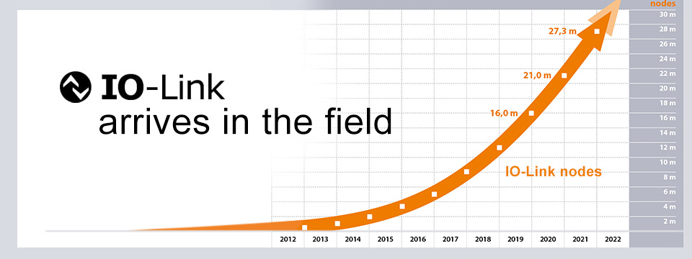
>27 million IO-Link nodes by end of 2021
More than 420 member
Companies worldwide
Notes:
An up-to-date picture can be taken from the IO-Link website: www.io-link.com
1. Go to Homepage.
2. Scroll pictures horizontally until you find the nodes graph.
3. Copy and paste picture using the right mouse button.

Slide 5

The IO-Link Story ("Version 1.1.3 or Package 2020")
Internet, IT,
Browser
PLC/FS-PLC/OPC-UA
Parameter server
Fieldbus controller
Engineering
Tool
Fieldbus
integration
IEC 61131-9
IEC 61139-2/3
e.g. XML, JSON
Ethernet
Embedded
controller:e.g.
Drive
UDP
Master Tool
(IODD; Firmware Update)
Webserver
OPC-UA
Fieldbus interface
Gateway Application
Gateway Application
GA
Standardized Master Interface (SMI)
Master / FS-Master / W-Master
Air interface
Port
Port
"Port"
Data storage
IODD
IODD
IO-Link
IODD
FS-Device
SCL
Device
Air interface
Application
Application
Dedicated
Tool
W-Device
Pairing
button
IODD
IODD
Application
IODD
Finder
IODD
Notes:
Slide demonstrates major features of IO-Link within automation:
1. Master for standard functionality; wired point-to point
2. FS-Master for functional safety; wired point-to point
3. W-Master for wireless transmission; virtual ports
4. Masters support "Data Storage" for Device's parameters; exchange w/o tools
5. "IO Device Descriptions" (IODD) as mandatory part of IO-Link devices
6. Dedicated Tool required for functional safety purposes (CRC signatures across
safety parameters)
7. IODDs can be acquired from central database via "IODD Finder" Tool
8. Master Tool for parameterization via IODD; diagnosis; test; firmware update
(see IO-Link specification "BLOB Transfer & Firmware Update")
9. New "Standardized Master Interface" (SMI) for harmonized Master behavior
10. Various Gateway Applications to embedded, Internet, Fieldbus, and Master Tool systems
11. Gateway Applications coordinate access to Devices, FS-Devices, W-Devices
12. Core IO-Link technology is standardized within IEC 61131-9
13. IO-Link safety technology is standardized within IEC 61139-2
14. IO-Link wireless technology is standardized within IEC 61139-3

Slide 6
Basics
IO-Link

Slide 7
IO-Link Topology (Point-to-Point)
Master
Unshielded cable
L+ (24 V)
C/Q (Signal)
Device
Port 1
(Class A)
L- (0 V)
Upper-level system
L+ (24 V)
C/Q (Signal)
Device
Port 2
(Class A)
L- (0 V)
. . .
Maximum 20 m
Notes:
Topology is point-to-point
Master port numbering from 1 to n; "0" reserved for IO-Link Safety
3 wires, unshielded cables
Maximum length is 20 m
Power supply: 24 V industry standard
No special ASIC required

Slide 8
Port Class A and B
Class A (Device)
2
I/Q
Master
2
1
Power 1
power
supply
1
4
C/Q
3
3
4
5
M12-4
Isolated from Power 1
2
P24 (Actuator)
Master
Power 2
extra
power
supply
Class B (Device)
2
1
Power 1
power
supply
1
4
C/Q
3
5
3
4
5
M12-5
N24 (Actuator)
Class B Ports shall be
marked unambiguously
Notes:
Power supply and signal options:
Port Class A with Power 1 (maximum of 1000 mA @ IO-Link Safety!)
Port Class B with extra Power 2, depending on type of connector ≥ 3,5 A and wire gauges
Power 1 electrically isolated from Power 2
Port Class B shall be marked since pin layout is not compatible with Class A

Slide 9
Class A Power Supply (Master and FS-Master)
IS_{M}
1000 mA
(current limit for
IO-Link Safety)
ISIR_{M min}
400 mA
Master can provide higher currents
IS_{M min}
200 mA
Minimum current of the Master port
Unspecified
behavior
50 ms
t
Notes:
Master class A power supply
Shall provide a certain charge within the first 50 ms to enable wake-up procedure of the Device afterwards
Shall provide a minimum of 200 mA after initial charge time
Master can provide higher currents
At least one FS-Master port provides a maximum of 1000 mA
Derating rules are allowed, they shall be described in user manual
Port power supply can be switched off and on via SMI_PowerOffOn service

Slide 10
SIO (Standard Input/output) to IO-Link communication
L+
Switching signal ("SIO")
1
SIO
C/Q
2
4
I/Q
3
COMx
4,8 / 38,4 / 230,4 kbit/s
IO-Link communication
L-
"Coded Switching"
Notes:
Power and signals compliant with IEC 61131-2
Dual mode standard Devices: SIO (Standard Input Output) or IO-Link Communication (migration strategy)
SIO means traditional "switching signals"
IOL communication means "coded switching signals"
Three transmission rates: COM1 = 4,8; COM2 = 38,4; COM3 = 230,4 kbit/s
Pin layout corresponds to IEC 60947-5-2

Slide 11
SIO to OSSDe and Functional Safety Communication
IOL-OSSDe
OFF state
Testpulses
IOL-OSSDe:
Equivalent signals
L+
OFF state
1
IOL-OSSDe
C/Q
2
4
I/Q
3
COMx
4,8 / 38,4 / 230,4 kbit/s
IO-Link Safety communication
L-
AIDA compatible!
OSSD: Output Switching Sensing Devices (Solid state outputs)
OSSDe: = OSSD with equivalent switching signals;
type C, class 1 according to Position Paper CB24I (ZVEI)
Notes:
Same as SIO and IO-Link communication
Pin layout corresponds to AIDA position paper
Safety: Dual mode FS-Devices: OSSDe (default) or IO-Link Safety communication
"e" stands for equivalent switching redundant signals
FS-Device output sends and reads back short test pulses for error detection
IO-Link Safety uses the I/Q signal line (Pin 2) for OSSDe operation (OSSD2e)
The German Car Manufacturers Association (AIDA) requires the same pin layout as IO-Link Safety.

Slide 12
Basic Start-up Procedure of IO-Link
Communication,
Identification
STARTUP
Wake-up pulse
Standard
Input/Output
(SIO/OSSD)
Mastercommand
Power-on
Fallback
OPERATE
Cyclic
Process Data
exchange
Configure,
Parameterize
PREOPERATE
Mastercommand
Notes:
Regular start-up of an IO-Link Device:
After power-on the Device goes into SIO mode, i.e. the signal on C/Q (Pin 4 ) is either "high" or "low". After a maximum of 300 ms it shall be ready for a Wake-up by the Master port the Device is connected to. Port goes either "low" or "high" for a defined time and thus creates a short current pulse to be detected by the Device.
Master ("port instance") switches to state STARTUP where it tries to communicate first with highest transmission rate COM3 and in case further down to slower rates (COM2, COM1) until success or retry. A Device response contains information on Master cycle time to be used for this Device.
Master System Management takes over responsibility in this state and checks revision and Device compatibility with the help of information in Direct Parameter Page 1 using acyclic data exchange. A MasterCommand causes the Device to switch to state PREOPERATE.
In PREOPERATE, the Master can for example assign basic parameter values to the Device for configuration, check Data Storage and transfer technology parameter values into the Device in case of Device replacement. A MasterCommand causes the Device to switch to state OPERATE.
In OPERATE, the Master starts exchanging Process Data (PD) along with On-request Data (OD) such as parameter, SystemCommands, and Events for diagnosis.

Slide 13
Upper-level Systems (fieldbus & FSCPs)
IO-Link Safety
Notes:
Usually, IO-Link Safety will be a companion technology to upper level safety systems such as safety fieldbuses.
The safety communications of such fieldbuses is standardized within IEC 61784-3 series as FSCPs.

Slide 14
Functional Safety Communication Profiles (FSCP)
FSCP 3
FSCP 6
FSCP 12
FSCP 1
FSCP 2
FSCP 14
FSCP 18
FSCP 13
Non-IEC
"A"
FSCP 17
Non-IEC
"C"
FSCP 8
IEC 61784-3-x:
Collection of FSCPs
Notes:
Usually, IO-Link Safety will be a companion technology to upper level safety systems such as safety fieldbuses.
The safety communications of such fieldbuses is standardized within IEC 61784-3 series as FSCPs.
FSCP1: FF-SIS → Foundation Fieldbus Safety Instrumented Systems
FSCP2: CIP Safety → Ethernet IP (ODVA)
FSCP3: PROFIsafe → PROFINET, PROFIBUS (PNO)
FSCP6: Interbus Safety
FSCP8: CC-Link Safety
FSCP12: Functional Safety over EtherCat (FSoE)
FSCP13: Powerlink Safety
FSCP14: EPA Safety
FSCP17: RAPInet Safety
FSCP18: SafetyNet_p
NonIEC A: AS-i Safety at Work
NonIEC C: CANopen Safety

Slide 15
"Black Channel" Architecture of FSCPs
Application
Application
Application
Application
"Safety Technology"
FSCP
FSCP
FSCP
FSCP
"Safety Layer"
Fieldbus
RIO-Gateway
Fieldbus
Fieldbus
Fieldbus
FSCP Message
"Black Channel"
Notes:
This figure demonstrates how a safety communication layer (FSCP) runs on top of the fieldbus layers.
The fieldbus layers are treated like a "black box" or "black channel". This means, the FSCPs are designed such that none of the securing mechanisms of the fieldbus are used for the securing concepts of the FSCP. They are independent and can be used not only for the fieldbus itself but for backplanes in remote I/Os as well (see "RIO-Gateway")
The safety communication layers usually extend the process safety data by an additional so-called safety code that ensures the necessary residual error rate.
Each device has its own functional safety technology (application) using the FSCP for exchanging safety data.

Slide 16
Safety Function (Example)
FS-PLC
Light Curtain
&
Drive
Remote I/O
FS-DI Channel
User Program
E-Stop
Notes:
In this example the safety data of the light curtain is just one bit as well as the safety data from the FS-DI channel to which the emergency stop button is connected via OSSD.
Both signals are sent via FSCP messages to the safety controller (FS-PLC). User program consists of a logical AND. The output of this AND is logically connected via FSCP message with the safe operation within the drive.
Safe operations within the drive are standardized in IEC 61800-5-2 (see slide 62). It could be
- STO (Safe Torque Off → power shut down)
- SOS (Safe Operating Stop → Motor position in closed loop control)
- SLS (Safe Limited Speed)
- etc.
Safety function is "tripped", if one of the sensors (Light curtain or E-Stop) are activated ("0"). Output of AND will be "0" also.
This corresponds to the "de-energize to trip" principle in classic relay-based safety technology (in German: "Ruhestromprinzip")

Slide 17
Current situation with FSCPs
IO-Link Safety
Notes:
Usually, IO-Link Safety will be a companion technology to upper level safety systems such as safety fieldbuses.
The safety communications of such fieldbuses is standardized within IEC 61784-3 series as FSCPs.

Slide 18

Manufacturer's Situation
Safety controller
(FS-PLC)
FS-PLC
Fieldbus / FSCP
Remote I/O with FS modules
FS-DI
Redundant signal lines
FS = functional safety
PLC = programmable logic controller
e.g. Emergency Stop
Notes:
This slide shows a fieldbus arrangement focusing on typical safety components such as:
Level switches,
Laser scanners,
Light curtains,
Drives/motors,
Robots,
Programmable logic controllers including safety data processing (FS-PLC)
Remote I/O with safety modules for
- Analog Input (measurement)
- Analog Output (positioner)
- Digital Input (Emergency Stops)
- Digital Output (Relay)
These components are using an FSCP for communication of safety data since a normal fieldbus cannot guarantee the required residual error rate for safety data transmission required by safety standards such as IEC 61508.
IO-Link Safety focuses on the typically redundant connections between Remote I/O safety modules and the final sensors and actuators. There are many different connection technologies with de-facto standards such as OSSD.

Slide 19
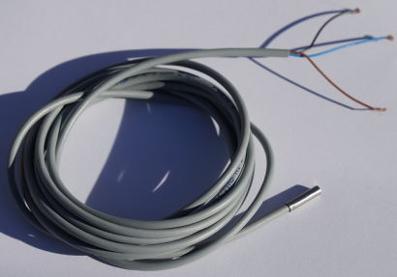
Customer's Situation
Machine builder decides on type of fieldbus to be used depending on deployment case
Thus, specific devices for each fieldbus with separate spares inventory, version maintenance and service are required
Thus, high degree of persistence to stay with "classic" interfaces such as OSSD, 4 to 20 mA, and etc. on "remote IO" field devices, since they are independent from fieldbus
However: no connection to Internet-of-Things (IoT) and Industry 4.0
Numerous new applications: (see "Smart Manufacturing")
- New sensor technologies, e.g. strain, torque, pressure, multi-sensing, and etc.
- More measuring sensors, e.g. object types, distance
- Mechatronics, e.g. combinations sensors/actuators
Progressive miniaturization
Notes:
No connection to Internet-of-Things (IoT) and Industry 4.0 means all the benefits of IO-Link and IO-Link Safety:
Connectors and wiring same as IO-Link. Power supply same as IO-Link. However, limited to 1000 mA with port Class A.
IO-Link Safety standardized an OSSDe (solid state outputs, equivalent switching redundant signals, specified test pulses)
Off-site parameterization and test also for safety devices that are intended for use on FS-DI modules within Remote I/Os.
IO-Link Safety communication is suitable for safety functions up to PLe or SIL3 respectively.
IO-Link Safety concept approved not only for cyclic safety communication protocol but for the entire parameterization and verification including functional safety Master Tools via Standardized Master Interface (SMI).
Device replacement not only for standard IO-Link but for FS-Devices also ("Data Storage").
Manufacturer can focus on one FS-Device for the entire world market.

Slide 20
IO-Link Safety with universal FS-Master
Fieldbus with one of the FSCPs (IEC 61784-3)
Compact
FS-Master (IP65)
Remote I/O
AI
AO
DI
DO
FS-Master
0
0
0
0
0
0
0
4
6
7
7
7
7
7
3
7
0 to 10 V
0 to 24 V
PM switching
IO-Link Safety
IO-Link
Analog
measure-
ments
Switches
Relays
Digitized
measure-
ments
OSSDe
or
COM
Low voltage
switch
gear
Drives
with
safety
Non safety
Device
Notes:
Refer to slide 18 (remote I/O)
Effect here is the same as with standard IO-Link. Instead of several different modules within a remote I/O such as FS-DI, FS-DO, FS-AI, and FS-AO, the user can focus on one FS-Master and save space, invest, and spares inventory .
Long lasting discussions for product managers about the number of channel types (how many FS-DI? FS-DO? FS-AI? Etc.) in compact devices can be alleviated → Just use a compact FS-Master with uniform Ports instead. They universally can be used for non-safety operation (DI, DO, COM) or safety operation (OSSDe, Safety COM).
Various different module interface technologies (OSSD, 0 to 10 V, 4 to 20 mA, etc.) become more and more obsolete.

Slide 21
Automation "hierarchy" with IO-Link Safety
PLC Level
Higher-Level Systems
(Functional Safety)
Fieldbus Level
Enabling New Markets
with FS-Master
(mapping and/or local processing)
safety
SIO
Mode
OSSDe
Mode
Sensor / Actuator /
IO-Link Devices and FS-Devices
Mechatronic Level
a Worldwide Standard
with IO-Link Safety
Devices
FS-Devices
Valves | Locking Units | Light Curtains
safety
Notes:
This figure shows how IO-Link Safety fits into the automation hierarchy with IO-Link. It is integrated and not separated in this pyramid.
It is assumed that PLCs provide features for safety data processing, so-called Safety PLCs, for example according IEC 61131-6. They receive safety data from functional safe sensing devices and send safety data to functional safe actuating devices.
On fieldbus level, IO-Link expands its product range now by Safety Masters (so-called FS-Master) that can play the role of a standard non-safety Master as well. That means, the following Devices can be connected:
Safety sensors (so-called sensing FS-Devices)
Safety actuators (so-called actuating FS-Devices)
Mixed safety devices (so-called mechatronic FS-Devices)
Safety sensors via OSSD (redundant switching signals)
Standard non-safety Devices
It is possible to enhance an FS-Master such that it is able to process safety signals and thus allow for local sub-"safety functions".

Slide 22
"Off-Site" Parameterization and Test (OSSDe)
Off-site configuration & parameterization
Fieldbus
F-DI Modul
FS-Master
"USB Master"
Tool software
with safety
0
0
0
0
IODD
Remote IO
7
7
7
7
USB
OSSDe
"USB-Master"
Parameter
Test
FS-Device
FS-Device
History
Notes:
Off-site means away from the machine or facility, for example in the office or "en route".
On-site means connected to the automation system of a machine or facility including IO-Link for commissioning, change or maintenance reasons.
Off-site configuration, parameterization and testing:
FS-Devices with standardized OSSDe can be connected to USB-Master for parameterization and test.
Parameterized FS-Device can be connected to FS-Digital Input module (remote I/O).
FS-Devices can be connected to USB-Master for parameterization and testing while in IO-Link Safety communication mode, if USB-Master supports this mode.
In the past, usually many different adapter cables between parameterization tools and safety devices have been necessary. (history).

Slide 23
Communication
IO-Link Safety
Notes:
What is IO-Link Safety communication all about?

Slide 24
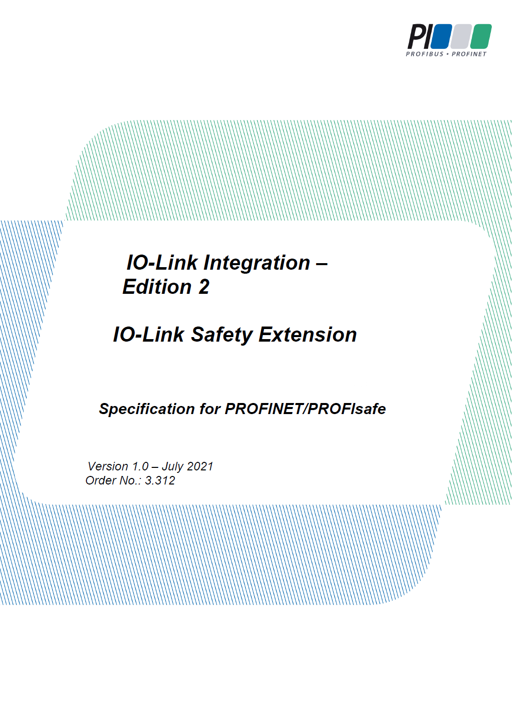
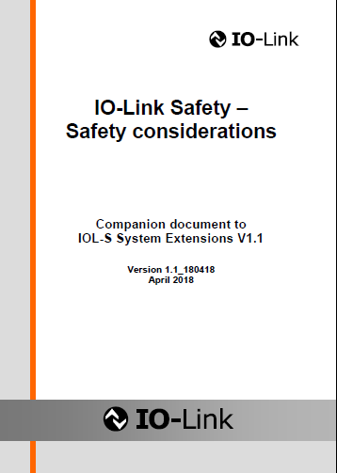
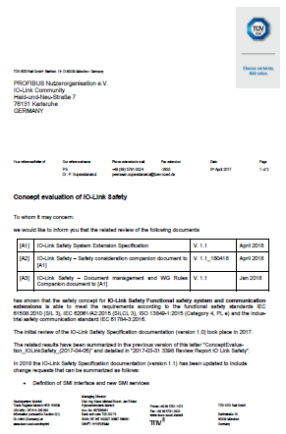
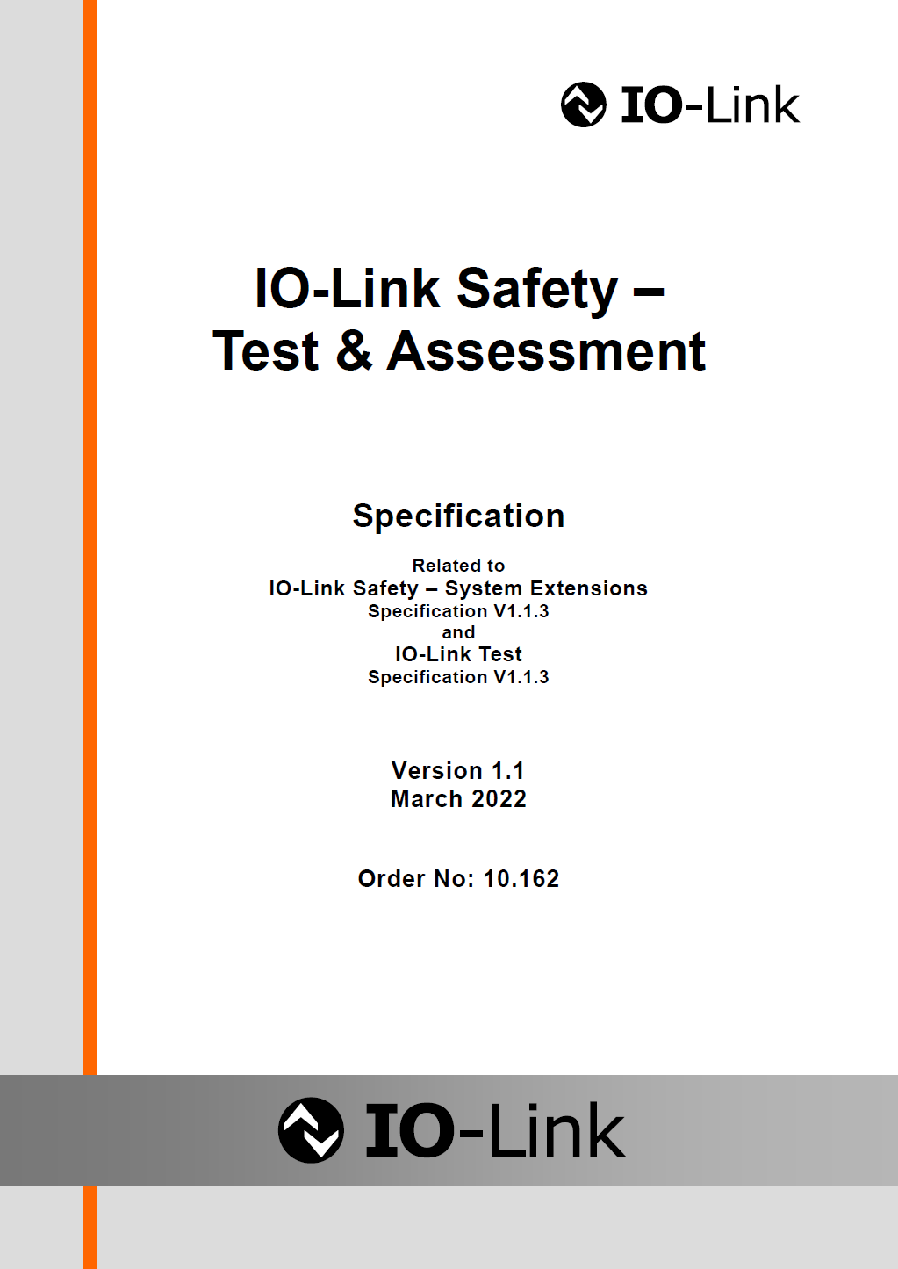
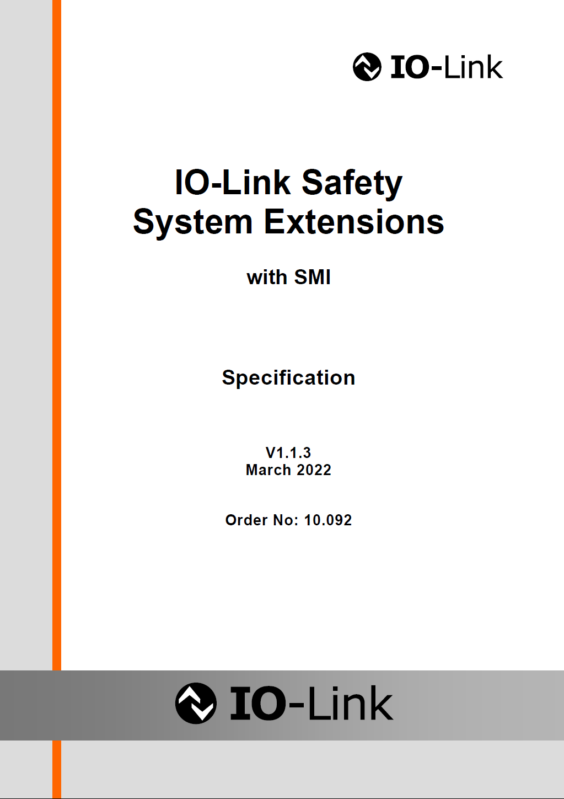
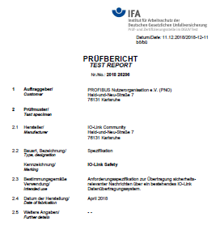
Specifications and Assessment Reports
PROFIsafe
Integration
V1.0
Notes:
First IO-Link Safety – System Extensions specification was published in April 2017. This version contained already everything to start implementation of the OSSDe, protocol and parameterization parts (important for technology providers).
Version 1.1 with SMI was published in April 2018. This version contains the new Standardized Master Interface (SMI) developed by the IO-Link Community (Coreteam) as basic technology for all new Masters. SMI is essential for IO-Link Safety since it allows for a complete assessment of the entire safety concepts of IO-Link Safety including the safety gateway.
Without SMI, this part of the assessment would have been on implementation (each designer/manufacturer) and not on concept level (working group only).
Final Version 1.1.3 covers important change requests and is the basis for the Committee Draft for Vote (CDV) of IEC 61139-2.
See slides 51 to 56 for details on SMI
See slide 59 to 61 for details on assessments
Besides IO-Link Safety System Extensions, the following documents have been developed:
Several documents for the safety assessment by assessment bodies
Version 1.1 of the IO-Link Safety – Test & Assessment with the automatically created test scripts for FS-Device and FS-Master Protocol Testers
White Paper for Integration of IO-Link Safety into FSCPs
Concept approval by TÜV-SÜD
Concept approval by IFA (German Berufsgenossenschaften)

Slide 25
"Black Channel" Principle also with IO-Link Safety
Safety application
Standard
application,
e.g. Diagnosis
Standard
application,
e.g. Diagnosis
Safety application
FSCP
(e.g. PROFIsafe)
Gateway
Safety
Communication
Layer (SCL)
IO-Link Safety
IO-Link Safety
Master
(Stack)
Device
(Stack)
IO-Link
("Black Channel")
Point-to-point communication
Notes:
This figure illustrates IO-Link Master and Device stacks as "black channel" for the safety communication layers (SCL) of IO-Link Safety.
Safety measures of IO-Link Safety do not take any benefits from the error detection mechanisms of the "black channel".
On FS-Device's side, the safety application corresponds to the firmware of the safety technology such as light curtain, laser scanner, strain, pressure or temperature transmitters, etc.
On FS-Master's side, the safety application is usually a gateway to an FSCP (safety PLC) or embedded safety system.

Slide 26
Messages with IO-Link Safety
Non-safety
Process
Data
Out
CRC
Signature
Control
&
M-Counter
Port
number
Safety
Process
Data
Out
From FS-Master:
32 to 0 octets
2/4 octets
1 octet
1 octet
3/25 octets
From FS-Device:
Safety
Process
Data
In
Port
Number
Status
&
D-Counter
CRC
Signature
Non-safety
Process
Data
In
3/25 octets
1 octet
1 octet
2/4 octets
32 to 0 octets
Notes:
Top figure demontrates an IO-Link Safety message from the FS-Master to the FS-Device. It starts with the output safety data, followed by the port number of the FS-Master, followed by a control byte including a 3-bit counter value, followed by a CRC signature across all yellow marked parts. Non-safety process data can be attached at the end. Their length depends on the length of the yellow part.
Two protocol modes are possible:
Short process data 0 to 3 octets with a CRC signature of 2 octets (optimized for fast operation)
Longer process data 0 to 25 octets with a CRC signature of 4 octets
The IO-Link Safety message from FS-Device to FS-Master corresponds to the message from the FS-Master except for:
Counter value is inverted
Port number is taken from a stored value during commissioning and inverted also.
Permitted data types are Boolean, Integer16, Integer32, Qualifier
Important to know is that IO-Link Safety uses explicitly transmitted safety codes (see IEC 61784-3).
Qualifier bits are used during mapping of safety data to FSCP layer.

Slide 27
Start-up and Securing Measures
Communication,
Identification
Wake-up
Ready
Selftest
SIO / OSSDe
Mastercommand
PowerOffOn
PowerOffOn
Cyclic
Process Data
exchange
Configure,
Parameterize
Mastercommand
Safety parameter verification (VerifyRecord)
Misconnection? (Authenticity/Port check)
Replacement? (Data Storage if "out-of-the-box")
Parameter verified?
→ Start safety communication (SCL)
Notes:
Regular start-up of an FS-Device:
After power-on the FS-Device goes into SIO mode, i.e. the signal on C/Q (Pin 4 ) is either "high" or "low". After safety self-tests, the FS-Device sends a "READY" pulse on C/Q, whereupon the FS-Master initiates IO-Link commun ication via a Wake-up pulse to the FS-Device: signal on C/Q goes either "low" or "high" for a defined time and thus creates a short current pulse to be detected by the FS-Device to start communication.
FS-Master ("port instance") switches to next state (STARTUP), where it negotiates the correct COM transmission rate until success or retry. An FS-Device response contains information on Master cycle time to be used for this Device. FS-Master System Management checks revision and FS-Device compatibility. A MasterCommand causes the FS-Device to switch to next state (PREOPERATE).
In this state, the FS-Master sends a so-called "VerifyRecord" with safety protocol parameters to the FS-Device to ensure correct parameterization of the FS-Device. In case of misconnected FS-Devices to either a wrong FS-Master or Port, the FS-Master detects incorrect authenticity parameter values creates an error message and blocks safety communications. In case of an FS-Device with "Out-of-the-Box" parameterization (= factory settings), the FS-Master activates the IO-Link Data Storage mechanism and transfers safety technology parameter values into the FS-Device (FS-Device replacement without tools). A MasterCommand causes the FS-Device to switch to the next state (OPERATE).
In this state, the FS-Master starts safety communication (SCL) if all safety parameters have been correct at evaluation.

Slide 28
Integration into FSCPs
IO-Link Safety
Notes:
What is IO-Link Safety communication all about?

Slide 29
Integration Objectives of IO-Link Safety
FSCP 3
FSCP 2
Ethernet-based
Ethernet-based
"Classic fieldbus"
"Classic fieldbus"
RIO
FS-DI
FS-Master 3
RIO
FS-DI
FS-Master 2
Switches,
OSSD,
OSSDe
"One" safety device with OSSDe and
IO-Link Safety communication
FS-Device
RIO = Remote I/O
RIO
FS-DI
FS-Master 12
RIO
FS-DI
FS-Master 8
Ethernet-based
"Classic fieldbus"
FSCP 12
FSCP 8
Ethernet-based
Notes:
For FS-Devices:
Dual mode operation:
OSSD, when connected to an FS-Digital Input module, or
IO-Link Safety communication, when connected to an FS-Master
For FS-Masters:
Usually, FS-Masters for the different fieldbuses/FSCPs can be realized as an FSCP node using existing FSCP development kits. The safety layers of the FSCP and of IO-Link Safety can be combined and encapsulated to achieve reasonable efforts for IO-Link Master manufacturers (see slides 53 and 54).
At least one FS-Master per FSCP is required for FS-Device manufacturers to enter into that particular market.

Slide 30
Prospects
FSCP A
FSCP B
Ethernet-based
Ethernet-based
"Classic"
"Classic"
RIO
FS-DI
IOL-S
RIO
FS-DI
IOL-S
③
Local signal processing
①
FS-Device
②
Dual mode FS-Device (OSSDe)
Largest commonality for
sensors, actuators, and
mechatronics
④
Port Class B
RIO
FS-DI
IOL-S
RIO
FS-DI
IOL-S
"Classic"
Ethernet-based
Ethernet-based
FSCP C
FSCP D
Notes:
As explained in previous slide, FS-Devices benefit from the largest commonality for safety sensors, actuators and mechatronics due to bi-directional communication of IO-Link Safety on any FS-Master.
Dual mode FS-Devices with standardized OSSDe allow for operation on classic FS-DI (digital input) modules within remote I/Os and with IO-Link Safety communication on FS-Master ports.
FS-Master ports with OSSDe capability allow for operation of dual mode FS-Devices or classic OSSD sensors according Type C of "ZVEI Position Paper CB24I" (see slide 28 and 30). This flexibility allows the customer to start with a classic OSSD sensor type in his application until a new version (FS-Device) will be available.
The encapsulation of the safety communication layers within an FS-Master allows for an extended mapping of the safety data including a safety logic processing unit. With the help of this unit local safety functions can be build using sensor and actuator FS-Devices connected to this particular FS-Master.
FS-Devices requiring more than 1000 mA (mostly actuators) can use FS-Masters providing port class B with extra Power supply 2 (see slide 6).

Slide 31
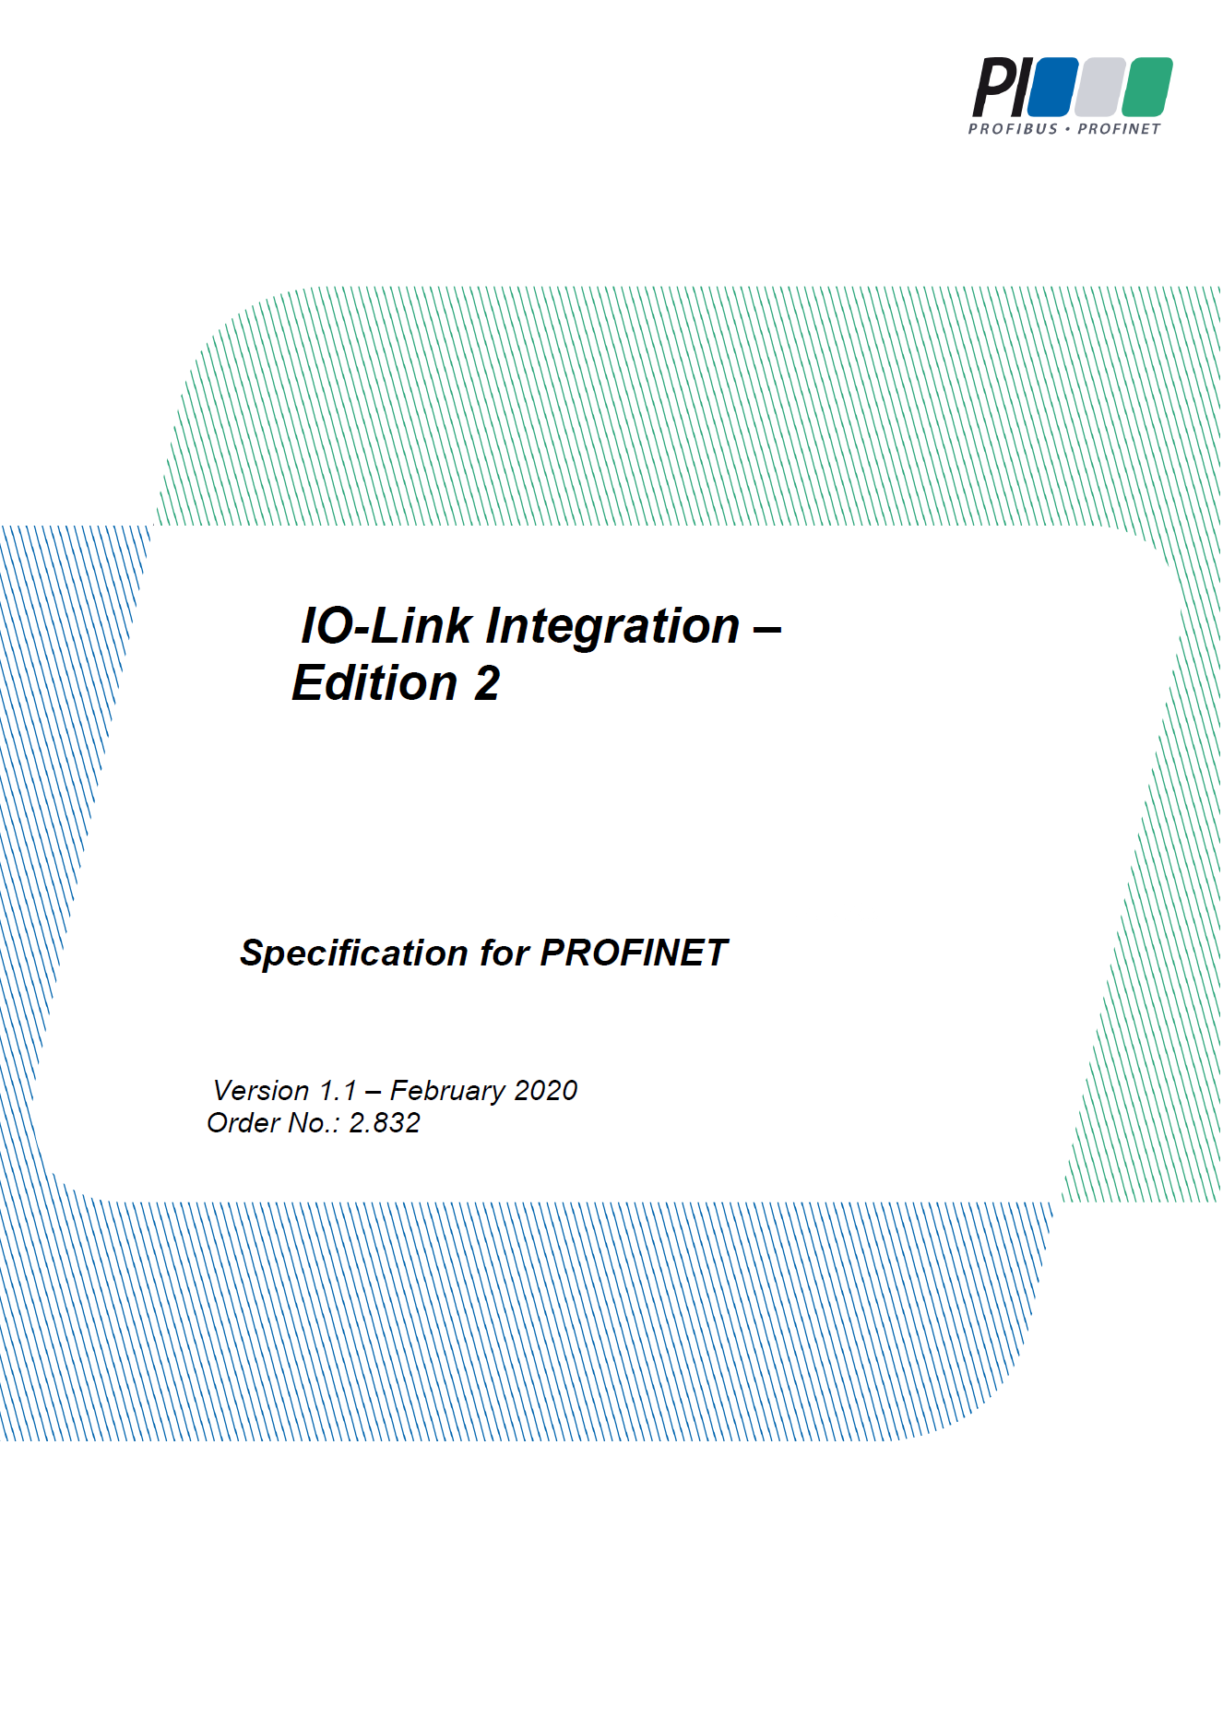
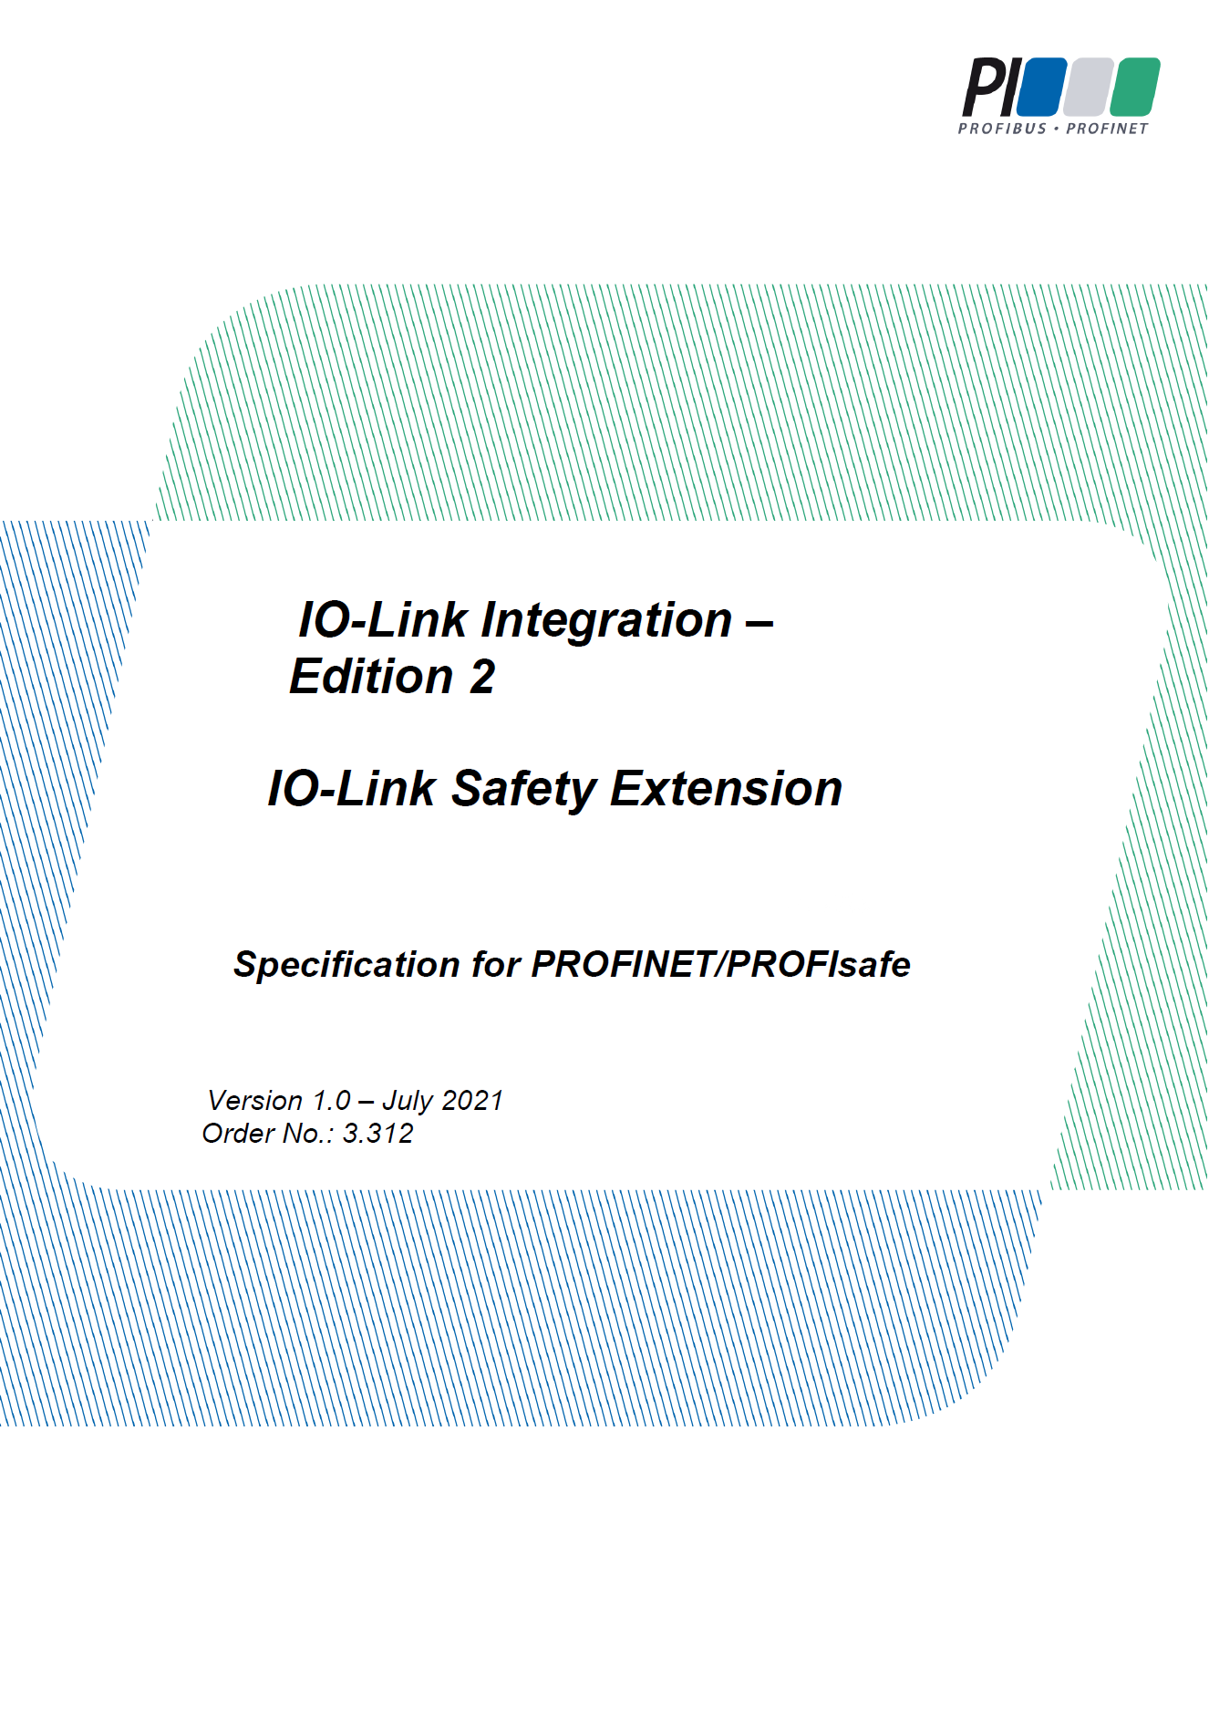
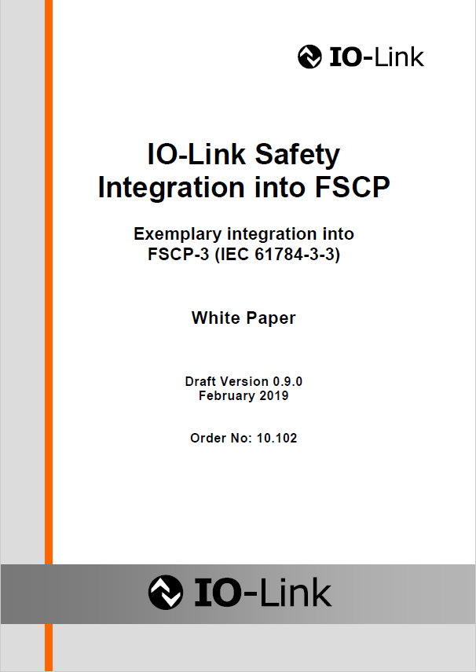
Integration
Available:
PROFINET / PROFIsafe
Role model for
Fieldbus / FSCP
PROFINET Integration
PROFIsafe Extension
White Paper
Available on:
www.io-link.com
Notes:
One of the IO-Link integration documents covers mapping of IO-Link to PROFINET. In the meantime, an IO-Link Safety Extension Version 1.0 is available from the PROFIBUS Nutzerorganisation e.V. This document supports integration of FS-Masters into PROFINET/PROFIsafe.
It is comprehensive and can serve as a role model for integrations. Thus, a White Paper with concepts for integration into Functional Safety Communication Profiles according to the IEC 61784-3-x series is also available and provided for download from the IO-Link websites in a neutralized form.

Slide 32


System Overview (PROFINET / IO-Link)
Engineering System
IO controller
IO supervisor
PROFINET
domain
PNIO
PROFINET/PROFIsafe
GSD
(IO device)
IO device
Linking Module (B)
"safety"
IO-
Link
FS-Master
IO-Link
PDCT
IO-
Link
Port 1
Port 4
Port 2
Port 3
IODD
(Device,
FS-Device)
IO-Link
domain
Off-site
commissioning
FS-Devices/Devices
Notes:
This overview shows exemplary via PROFINET/PROFIsafe, how a so-called Linking Module provides the gateway with the mapping of safety Process Data.

Slide 33
Safety is Linear Extension of Fieldbus Integration (Example PN)
PROFIsafe development kit
PROFIsafe services +
Protocol state machine
PROFINET
PROFIsafe
Gateway: PROFINET IO-Link Integration
("Linking Modules")
PROFIsafe
FS-IO mapping
PROFIsafe ‒ IO-Link
Safety Gateway
IO-Link Safety
(COM)
FS-DI
(OSSDe)
IO-Link Safety services +
Protocol state machine
Standardized Master Interface (SMI)
Configuration
Manager
(Parameter)
Data
Storage
Acyclic
Data
Exchange
Diagnosis
Unit
Splitter/Composer
IO-Link Safety
Cyclic Process
Data Exchange
Master layers
FS-Device
Notes:
Safety integration is a linear extension of the fieldbus integration. Usually, there exist development kits for particular FSCPs such as PROFIsafe.
In case of SIL3 applications, these development kits recommend redundant microcontrollers to carry the FSCP protocol firmware.
IO-Link Safety fits well into this approach since it can be implemented totally hardware independent.
This figure shows also the "black channel" character of the FS-Master. The core part is a standard non-safety IO-Link Master with two modifications:
An FS-Master Port is able to sense the "READY" pulse of an FS-Device
An FS-Master is able to split the SPDU (safety protocol data unit) from the entire IO-Link message. In contrast, an FS-Master is able to compose an entire IO-Link message out of an SPDU and a non-safety data part.

Slide 34
Example Multi-PROFIsafe-Instance
PROFIsafe instance 1
PROFIsafe instance 2
PROFIsafe instance 3
Device catalog
In
Out
Head module
Submodules
…
♦ IOL Generic Devices
In/Out 32/32 Byte + PQI
In/Out 16/16 Byte + PQI
In/Out 8/8 Byte + PQI
In/Out 4/4 Byte + PQI
In/Out 2/2 Byte + PQI
In/Out 0/0 Byte + PQI
♦ IOL Safety Data
OSSD Container
Safety Input U8
Safety Output U8
Safety Input Int16
Safety Input + Output U8
Safety Input + Output 2 x U8
Safety Input 4 x I16 + U8
8 × Bool
‒
Slot k
In
Out
SS1
SS2
SS3
SS4
SS5
SS6
SS7
SS8
Integer16
‒
In
Out
Integer16
Integer16
Integer16
Integer16
8 × Bool
‒
I/O 0/0 Byte + PQI
I/O 0/0 Byte + PQI
I/O 0/0 Byte + PQI
4 Port FS-Master
OSSD Container
Safety Input I16
Safety Output U8
Safety Input U8
In
Out
‒
8 × Bool
Port 1
Port 2
Port 3
In
Out
COM
COM
COM
8 × Bool
8 × Bool
GSD
(Linking Module,
PROFIsafe)
In
Out
Int16 in
8 bit out
4 bit in
8 × Bool
8 × Bool
8 × Bool
8 × Bool
Notes:
This detailed mapping scheme shows exemplary how the Ports of an FS-Master are mapped into a pair of subslots of the Linking Module, one for non-safety and another one for safety data of a connected FS-Device.
The safety data are finally mapped into a PROFIsafe message ("instance").
The GSD file of the Linking Module provides the possible "containers" for the non-safety Subslots (see IOL Generic Devices) and the possible "containers" for the safety Subslots (see IOL Safety Data).
A special Subslot, assigned to the FS-Master, can be used for the efficient mapping of single bits to one PROFIsafe message ("OSSD Container").

Slide 35
Test & Certification
IO-Link Safety
Notes:
Which kind of testers are available?
What kind of assessment and certification rules exist?

Slide 36
Test & Assessment
Step 1 achieved in 2019: Draft V1.0 with SCL + OSSDe
Step 2 V1.1 comprises the complete set of test cases
Content:
OSSDe
FS-Device functions
FS-Master functions
SCL tests (automated test script generation)
FS-Master Tool tests
Assessment & certification
SCL = Safety Communication Layer
Notes:
Content:
Physical layer tests (OSSDe)
IODD checks
Configuration test for FS-Devices
Safety communication test scripts for FS-Devices (automatically created)
Verification tests for FS-Devices (VerifyRecord)
Reference test for FS-Devices (entire integration)
FS-Master protocol test
Safety communication test scripts for FS-Masters (automatically created)
Reference test for FS-Masters (entire integration)
Environmental tests
Annex A: Testing principles
Annex B: Assessment
Annex C: Conformity
Annex D: Manufacturer declaration

Slide 37
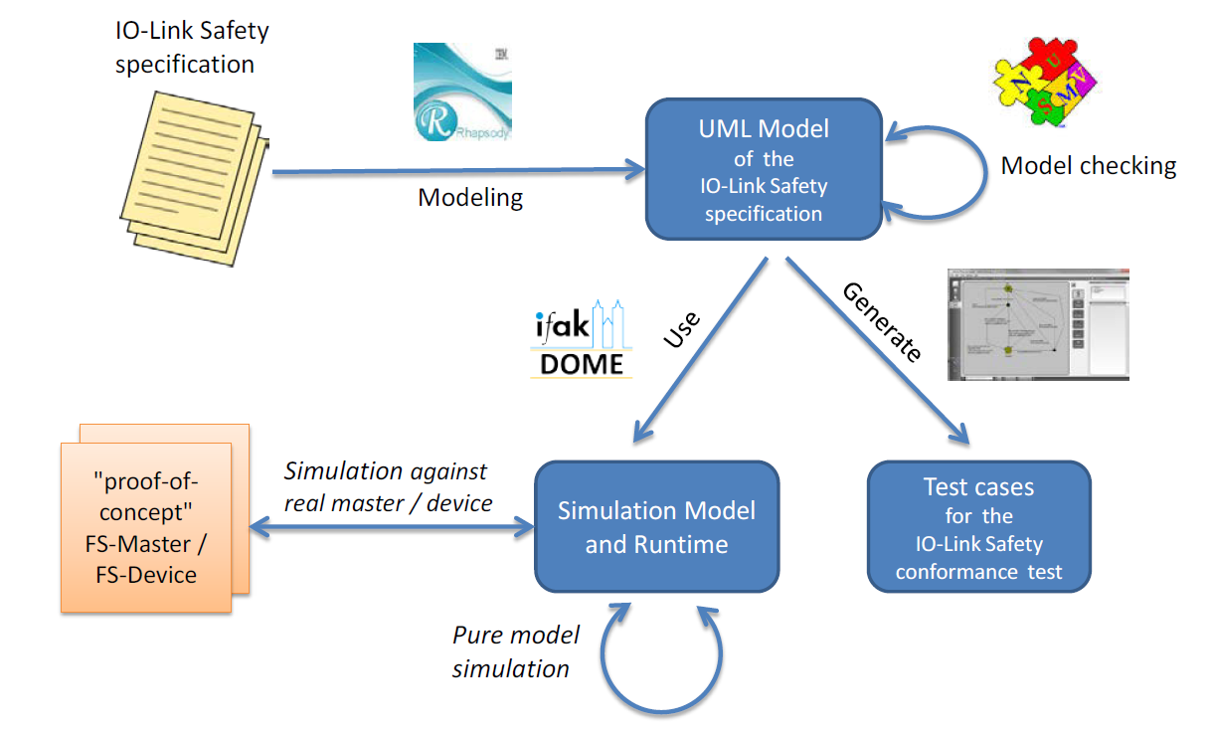
Automated Test Case Generation
Test scripts
Sequence charts
IO-Link Tester
Notes:
The test patterns for the safety communication layer tester for FS-Device and FS-Master have been created automatically during simulation of the FS-Master and FS-Device state machines.
Modeling of the protocol state machines was done using Unified Modeling Language technology.
Model checking was performed to find systematic design errors such as dead-locks and etc.
Simulation was performed using the UML model to find out resilience of the model against errors or failures . Several use cases lead to corresponding sequence charts.
Last but not least, a test case generator was used to create automatically test cases with a test coverage of 100% applying Modified Condition/Decision Coverage approach. This way many redundant test cases could be sorted out in order to create a set of relevant test cases.

Slide 38
FS-Master Tester
Fieldbus
Initialize FS-Master, and
Activate test mode, and
PowerOFF/ON
SMI
e.g. USB
Fieldbus-
Interface
FS-Master
(EUT)
Non safety part used as "test control channel" to "UT"
FS-Master-
Tester-HW
FSCP
UT
IOL-Safety
SPDU
Test-
FW
Mapper
IO-Link
SPDU
Message
Notes:
The FS-Master Tester consists of the following parts and subparts:
The test program runs in a laptop and uses the test scripts we have seen within the last slide.
Via USB it is connected to the special "FS-Master Tester Hardware" playing the role of an "FS-Device" to the FS-Master (equipment under test).
The special "FS-Master Tester Hardware" receives the test scripts and stimulates the IO-Link Safety communication test case by test case.
This way IO-Link messages with an SPDU arrive at the FS-Master's IOL-Safety layer and the Mapper to the upper-level-system "FSCP".
The non-safety part of the messages is used as a means to mirror back the received signals and data to the "FS-Master Tester Hardware" and finally to the test program in the laptop for evaluation.
The next slide illustrates how this signal and data mirror works.

Slide 39
FS-Master Tester (without fieldbus dependency)
Fieldbus layers / Ethernet
Gateway IO-Link/PROFINET
FSCP
FSCP Test
FS mapping
FS-Master
IO-Link Safety
Temporary
test signal channel
(part of the safety implementation)
Standardized Master Interface (SMI)
Master layers
IO-Link safety Test
SPDU
Test signal data
FS-Master Tester
Notes:
The mapping unit contains a so-called Upper Tester layer, which mirrors signals and data between the safety and the non-safety channels ("temporary test signal channel"). This blue colored part can be switched on via safety protocol parameters for protocol testing purposes.
This approach allows for a simple and efficient protocol testing (FS-Master Tester) independent from a particular FSCP.

Slide 40
FS-Device Tester
e.g. USB
FS-Device-
Tester
FS-Device
(EUT)
IO-Link
Notes:
Extension of standard non-safety Device tester. Test scripts can be configured to adapt to the process data of the FS-Device defined in its IODD.

Slide 41
Assessment & Certification (FS-Device or stand-alone FS-Master)
IO-Link partner starts developing an FS-Device or stand-alone FS-Master
Availability, immunity and electrical safety (IO-Link)
Functional Safety
Immunity (EMC) + E-safety
Interoperability (IO-Link)
Conformance (IEC 61508)
EMC test
Electrical safety check
IO-Link VendorID
Basic IO-Link Device test ("black channel")
Test Center (fulfills Testlab instructions):
Test of FS-Device (SCL + optionally OSSDe)
"Reference standard"
Safety assessment by
Assessment Body
Optionally: Role of the Test Center
Test of FS-Device (SCL + opt. OSSDe) "Test standard"
Corrections
not passed
passed
+
Test and check successfully passed
Assessment successfully passed
IO-Link manufacturer declaration
Including certificate number
Certificate from Assessment Body
Notes:
Test, assessment, and certification of FS-Devices comprise three aspects:
- Conformity with regulations, for example European directives (EMC for functional safety
such as IEC 61000-6-7 and electrical safety such as IEC 61010-2-201) or Underwriters
Laboratories – UL (UL508 – "Class 2", single fault prove)
- IO-Link Interoperability (conformity of the FS-Device with the IO-Link specifications: The
IO-Link community arranged for "Test standards" based on the Test & Assessment
specification and supported by Technology Providers)
- Conformance of functional safety development process with IEC 61508 (due to
software/firmware involvement)
While developers can use the IO-Link "Test Standards" during development to ensure a high degree of conformity/interoperability with IO-Link and IO-Link Safety, this is not enough for functional safety. IO-Link Safety requires particular Test Centers assessed by the IO-Link Community and an Assessment Body and audited periodically. These Test Centers are performing tests and checks according to approved "Test Lab Instructions" and using approved "Reference Standards". "Test Standards" and "Reference Standards" correspond to each other. However, while the "Test Standards" can be variable to a certain extent, the "Reference Tests" are fixed and "locked" by CRC signature.
A safety assessment body can play the role of a Test Center on behalf of the IO-Link Community, thus reducing time and effort.
After the final certificate of the Assessment Body, the FS-Device manufacturer can issue the IO-Link Safety Manufacturer declaration showing the certificate number of the assessment.

Slide 42
Assessment & Certification (FS-Master on Fieldbus/FSCP)
IO-Link partner starts developing an FS-Master
Availability, immunity and electrical safety (Fieldbus and IO-Link)
Functional Safety
Immunity (EMC) + E-safety
Interoperability (Fieldbus and IO-Link)
Conformance (IEC 61508)
EMC test
Electrical safety check
Prove Fieldbus and FSCP conformity
IO-Link VendorID
Basic IO-Link Master test ("black channel")
Test Center (fulfills Testlab instructions):
Test of FS-Master (SCL + optionally OSSDe)
"Reference standard"
Safety assessment by
Assessment Body
Optionally: Role of the Test Center
Test of FS-Master (SCL + opt. OSSDe) "Test standard"
Corrections
not passed
passed
+
Test and check successfully passed
Assessment successfully passed
IO-Link manufacturer declaration
Including certificate number
Certificate from Assessment Body
Notes:
Assessment and certification of FS-Masters on fieldbus/FSCP follows a similar concept:
EMC tests and electrical safety issues can be different depending on the standards to be considered (generic, domain, or product)
Usually, from a fieldbus/FSCP point-of-view, the FS-Master is a fieldbus device and has to be developed, tested, and assessed according to the interoperability/conformity rules of the particular fieldbus/FSCP. The result is a certificate of the fieldbus organization.
The remaining steps correspond to those of an FS-Device.

Slide 43
Development SUPPORT
IO-Link Safety
Notes:
How can I get help for my development?

Slide 44
Technology Provider
"Development Support"
  "Functional" versions for FS-Device and FS-Masters are already available (no SIL).
  Developers can implement without waiting on an "official" counterpart of the market
"Starterkits"
  "Functional safety" versions are just showing up (SPS Fair 2022)
  Safety development with support from assessment bodies
  Pre-certified "SCL-Stack" software for up to SIL3/PLe
  Architecture, design, and testing according IEC 61508/ISO 13849,
  Implementation µC independent ("ANSI-C") and according MISRA (2012) standard,
  Product and marketing strategy depending on technology provider
FS-Master
FS-Device Dev.
FS-Master Dev.
FS-Device
FS-Master + Tool
Software stacks
Notes:
Inexpensive "counterpart" FS-Master tools for my development of FS-Devices and inexpensive "counterpart" FS-Device tools for my development of FS-Masters.
Pre-certified software stacks and tools for the IO-Link and IO-Link Safety communication parts of my project such that I can focus on may safety application (sensor, actuator, or mechatronic) and save hazzles, time, and money.

Slide 45
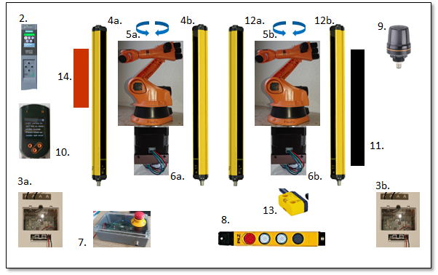
What's next?
Certified Designer training classes starting in fall 2022
Live Demo at the SPS Fair 2022
Finalize agreement with TÜV-SÜD for IO-Link Safety Test Center
Encourage and enable other FSCP integrations (FSoE, CIP-Safety, and etc.)

Slide 46






















Working Group Members

Slide 47

Benefits of IO-Link Safety
Wiring &
Power supply
(IO-Link)
COM + 24 V
New
Standardized OSSDe
One FS-Device for the world market (all FSCPs)
Benefits of
IO-Link Safety
FS-Device Replacement w/o Tools
On/Off-site Parameterization & Test (IODD)
Detection of Misconnection
Safety Communication,
bidirectional
SIL3
PLe

Slide 48

Thank you!
See you @

